Slide 1
USEFUL JAPANESE DICTIONARY FOR VIETNAMESE
Supervisor: Nguyễn Văn Sang
Lê Đình Nam se02316
Phạm Thị Minh se02300
Phạm Tiến Đạt se02336
Nguyễn Ngọc Tuấn se02189

Slide 2
Problem Definition
The Idea
System purpose/ objective
Requirements
Functionalities

Slide 3
Problem Definition
Demand of learning Japanese high
Learning online
Nowadays, the relation of Vietnam and Japan is very good, Japan market need more human resource of Vietnam in many fields, special IT.
Have a lot of Japanese training center
With technology development, there are many websites to learn Japanese with many types and languages. Moreover it requests user upgrade account to learn.
Because number of people learn Japanese is crowd, series of centers are opened but they cannot control of training quality.

Slide 4
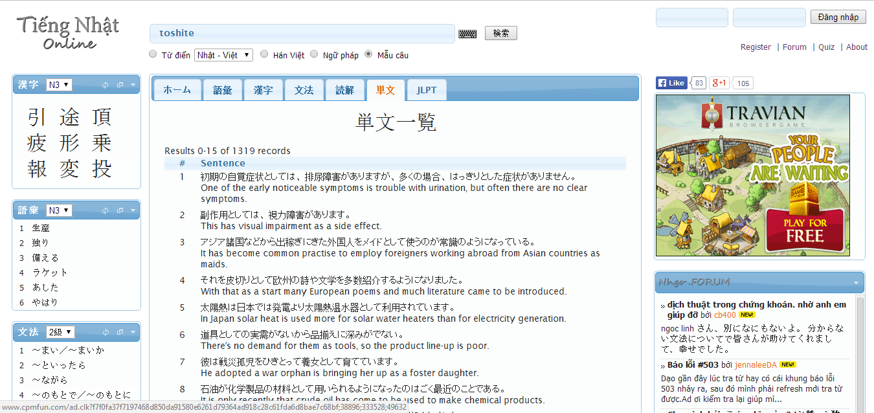
Problem Definition
With purpose is save time, many users choose study online likes a best way. But nowadays, have not website really good for Vietnamese.
Search with more option, but more words have not meaning with Vietnamese
Search Kanji, grammar
Post question
Do not support Viet-Nhat dictionary
Do not support listening, reading, conservation …

Slide 5
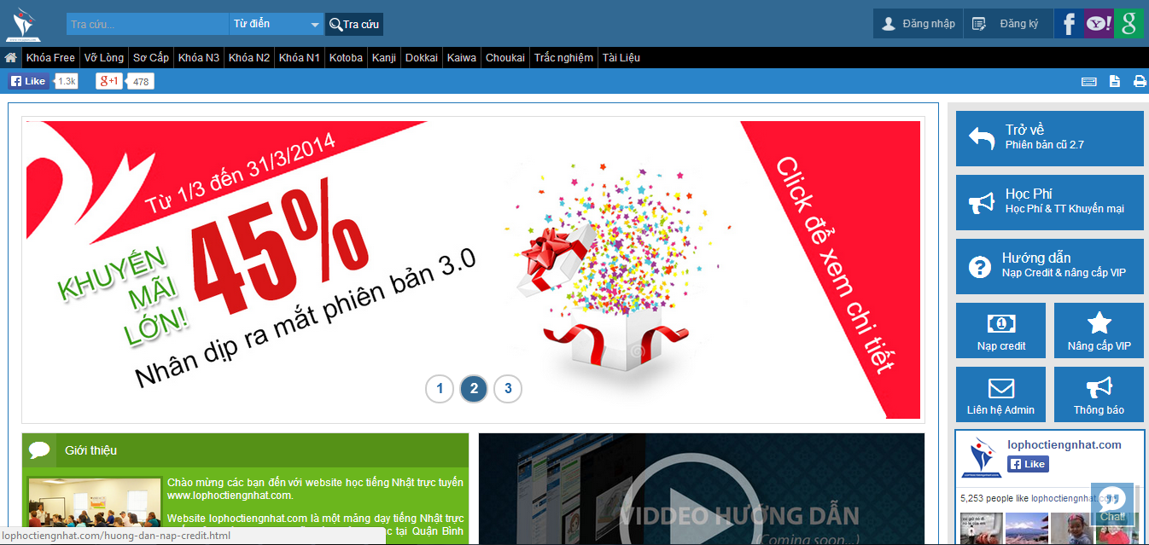
Problem Definition
Full support with listening, reading, conservation
Support search but too simple
Have to register and upgrade account to study

Slide 6
The idea
Reducing above gaps and integrating important function to help user by a best way. UJD_VN will bring to user:
User only need a laptop connect to internet, use any browser to access website
Friendly interface, easy to use by Vietnamese language
User have not to mind about upgrading account to study
Full of sections to user can choose, such as: reading, listening, conservation, video, testing, review JLPT…
Specially, search function with full option to help user maximum
User can contribute opinion and data

Slide 7
Objectives
To meet requirements from FPT University, we have to complete this project, it is conditional for us to graduate.
Applying knowledge during in 4 years to complete project successfully
Studying more about: Java script, PHP, HTML, …
Understanding of software development process of F-soft
Learning manage project and time
Improving soft skill and working in group

Slide 8
Functional Requirements
Member:
1. Searching word with more options:
Search sentences
Search grammar
Search conversation
Search specialized Japanese
Search video

Slide 9
Functional Requirements
2. Training listening: Member can choose section depend on level (N2, N3, N4). Member listen to question then choose answer. If member choose wrong answer and want to see answer, Website provides correct answer below
3. Reading document: Member can read document relate to foundamental, intermediate , grammar, JLPT
4. Listening conversation: Member can choose ‘Daily conversation’ or ’Common conversation’ to practice listening
5. Contacting admin: when member have good document, good idea or question; member can choose 3 options ‘Contribute content’ , ‘Contribute opinion’ or ‘send Q&A’ to send to admin, then admin will reply to member

Slide 10
Functional Requirements
6.Log in: Member can log in to website by registered account or Facbook account, Google account
7. Doing test: When member loged in, member can do test depend on level, in each level have full section to member test: reading, listening, garmmar, vocabulary. When member finishs test, they can save mark to tracking.
8. Managing account: Member can edit profile, review mark
9. Forgeting password: If member forget password, user can receive new passowd by email
10. Log out

Slide 11
Functional Requirements
Guest:
- In general, guest can do almost function of member, exception:
+ Doing test
+ Contacting admin
- Guest can register by new account or Facbook account, Google account

Slide 12
Functional Requirements
Admin:
Managing member’ account: Admin can search member, ban/ unban member, delete member
Managing admin’s account: Admin can add new admin, delete admin, edit profile
Managing contribute content: Admin can search content, approve content, delete content, reply to user
Managing contribute opinion: Admin can search opinion, delete opinion, reply to user
Managing Q&A: Admin can search Q&A, delete Q&A, reply to user

Slide 13
Functional Requirements
6. Managing vocabulary database: Admin can search, add, edit, delete vocabulary
7. Managing grammar database: Admin can search, add, edit, delete grammar
8. Managing reading document database: Admin can search, add, edit, delete reading document
9. Managing listening database: Admin can search, add, edit, delete listening
10. Managing doing test database: Admin can search, add, edit, delete doing test
11. Managing video database: Admin can search, add, edit, delete video

Slide 14
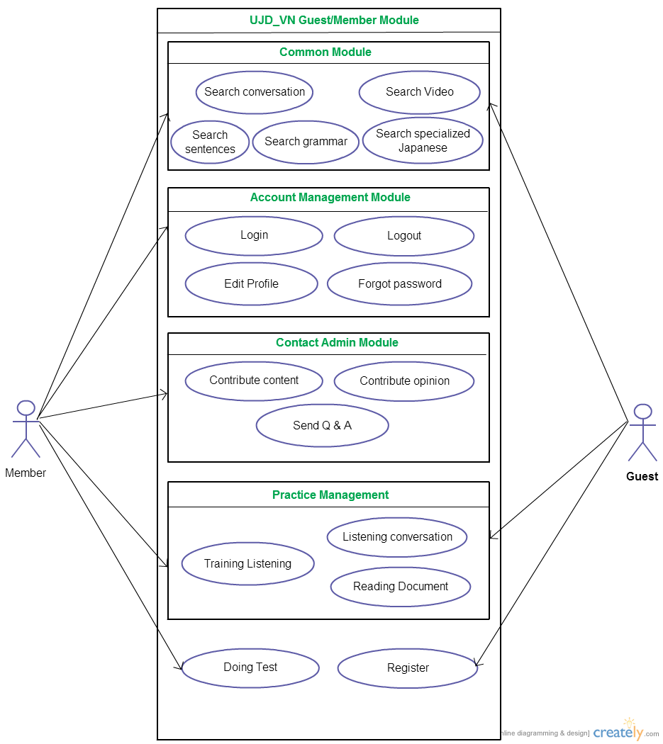
Use case diagram

Slide 15
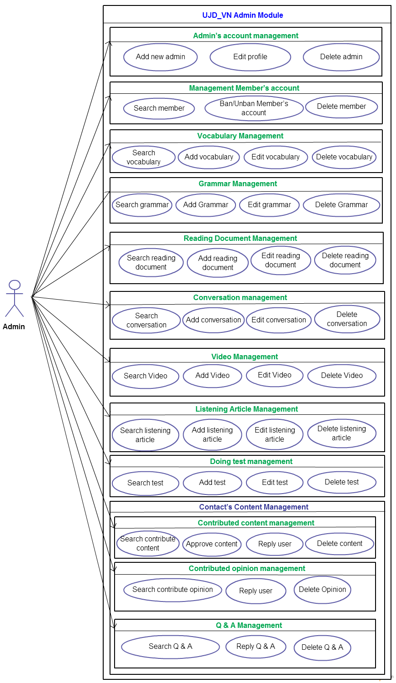

Slide 16
Functionality
MEMBER:
1. SEARCH:
- Search sentences: When member enter a word then choose option ‘Search sentence’, website will return meaning of word and related example sentences.
Search conversation: When member enter keyword then choose option ‘Search conversation’, website will return related conversations
Search grammar: When member enter a grammar then choose option ‘Search grammar’, website will return meaning of grammar and related example sentences.
Search video: When member enter keyword then choose option ‘Search video’, website will return related video
Search specialized Japanese: When member enter word then choose option ‘Search specialized Japanese’, website will return meaning of word and related example sentences.

Slide 17
2. LOG IN:
Member can log in by registered account, facbook account, google acccount
When member loged in, member can use more features such as: doing test then save mark, contact to admin
3. LOG OUT
4. EDIT PROFILE
When member loged in, member can edit name and change password
5. FORGOT PASWORD
- If member forgot password, user can click link ‘Forgot password’ to recieve new password by email

Slide 18
6. CONTACT ADMIN
- If member have any questions, or want to contribute content/ opinion for website. Member can send to admin, admin with reply member’s question, approve content to add database.
7. DOING TEST
Member can do test with sections: reading, listening, vocabulary, grammar. When member finish test, member can save mark. Mark will be tracked in account management.
8. TRAINING LISTENING
Member can listen then choose answer, below of listen article will have correct answer to member check.
9. LISTENING CONVERSATION
Member can choose’ Daily conversation’ or ‘ Common conversation’ to listen
10. READING DOCUMENT
- Member can read document at fundamental section, intermediate section, review section

Slide 19
Guest
1. REGISTER:
Guest can register account to use full function of website. If not guest cannot doing test and contact to admin
After register, guest have full of above functions likes member

Slide 20
ADMIN
1. ADMIN’S ACCOUNT MANAGEMENT
Add new admin: admin can add new admin to manage website easily.
Edit profile: admin can edit admin’s profile
Delete admin: admin can delete admin if these admin is not necessary
2. Management Member’s account
Search member: Admin can search member a faster way
Ban/Unban Member’s account: If member spam or violate website’s rule, admin can ban member’s account.
Delete Member: Admin can delete member

Slide 21
3. VOCABULARY MANAGEMENT
- Search vocabulary: Admin can search vocabulary to look up a faster way
Add vocabulary: Admin can add new vocabulary to make varied database
Edit vocabulary: Admin can edit information of vocabulary
Delete vocabulary: Admin can delete vocabulary
4. GRAMMAR MANAGEMENT
Search Grammar: Admin can search grammar to look up a faster way
Add Grammar: Admin can add new grammar to make varied database
Edit Grammar: Admin can edit information of grammar
Delete Grammar: Admin can delete grammar when it is not appropriate

Slide 22
5. READING DOCUMENT MANAGEMENT
Search reading document: Admin can search reading document to manage easily
Add reading document: Admin can add new reading document to provide for member and guest
Edit reading document: Admin can edit a reading document to appropriate with website
Delete reading document: Admin can delete a reading document
6. CONVERSATION MANAGEMENT
Search conversation: Admin can search conversation to manage easily
Add conversation: Admin can add new conversation to provide for member and guest
Edit conversation: Admin can edit conversation to appropriate with user's demand
Delete conversation: Admin can delete conversation when it is not necessary

Slide 23
7. VIDEO MANAGEMENT
- Search video : Admin can search video by name of video in list video.
- Add video : Admin can add new video to database.
- Edit video : Admin can edit name of video.
- Delete video : Admin can delete video in database.
8. LISTENING ARTICLE MANAGEMENT
- Search listening article : Admin can search listening article by name of listening article in database.
- Add listening article : Admin can add new listening article to database.
- Edit listening article : Admin can edit name of listening article .
- Delete listening article : Admin can delete listening article in database

Slide 24
9. DOING TEST MANAGEMENT
- Search test : Admin can search test by name of test in list test.
- Add test : Admin can add new test to database.
- Edit test : Admin can edit content of test.
- Delete test : Admin can delete test in database.
10. CONTRIBUTED CONTENT MANAGEMENT
- Search contribute content : Admin can search contribute content by choose option contribute and view list contribute about option.
- Approve content : Admin can approve content and add to database.
- Reply user : Admin can reply to user about contribute content.
- Delete content : Admin can delete contribute content if they not available.

Slide 25
11. CONTRIBUTED OPINION MANAGEMENT
- Search contribute opinion : Admin can search contribute opinion by keyword and view list opinion.
- Reply user : Admin can reply to user about opinion content.
- Delete opinion : Admin can delete opinion content if they not available.
12. Q & A MANAGEMENT
- Search Q & A : Admin can search Q & A by keyword and view list Q & A .
- Reply Q & A : Admin can reply to user about Q & A .
- Delete Q & A : Admin can delete Q & A if they not available.

Slide 26
Non-Functional Requirements
Performance: time to response, time of processing.
Availability: hours of operation
Maintainability: architectural standards, coding standards.
Usability: friendly, interactive.
Capacity and scalability: throughput, storage and growth requirements.

Slide 27


